Slide 1

Business Planning
COMP.5204 Enterprise
Group Activity

Slide 2

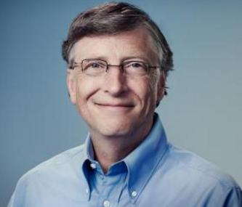
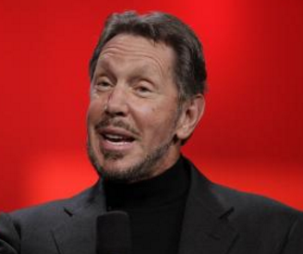
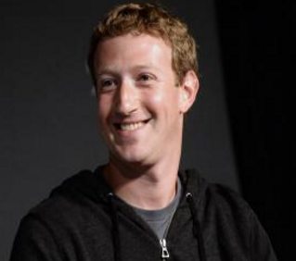
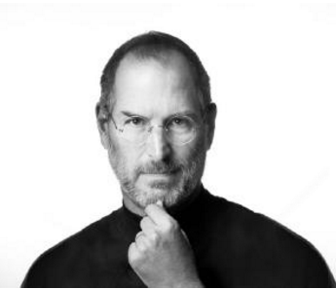
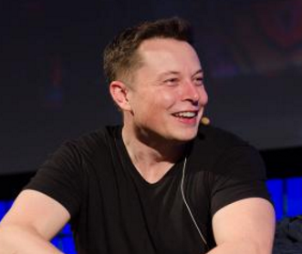
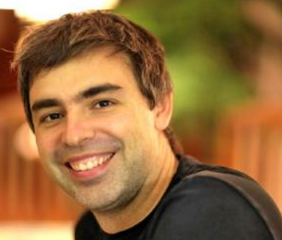
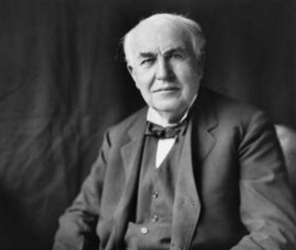
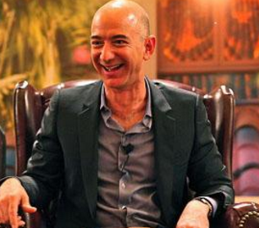
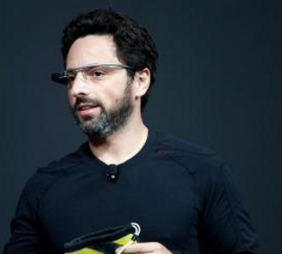
Famous Business People.
Can you name these well known business people?
Notes:
Larry Ellison (Oracle), Steve Jobs (Apple), Elon Musk (Tesla), Mark Zuckerberg (Facebook), Bill Gates (Microsoft), Larry Page (Google), Thomas Edison, Jeff Bezos (Amazon), Sergey Brin (Google)

Slide 3

Group Activity.
Get into groups of 2 or 3
Come up with a business idea (related to Information Technology)
What tasks would you need to accomplish to get your business started?
What tasks and resources would you need to keep your business running?

Slide 4
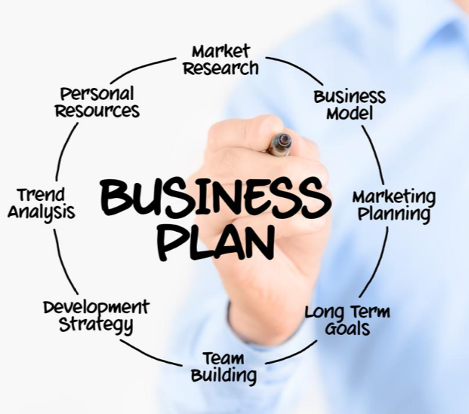

Create a business Plan
What is a business plan? (Discuss)
https://www.business.govt.nz/getting-started/business-planning-tools-and-tips/introduction-to-business-planning/
Create a business plan for your idea.
https://www.business.govt.nz/getting-started/business-planning-tools-and-tips/how-to-create-a-business-plan/

